Slide 1
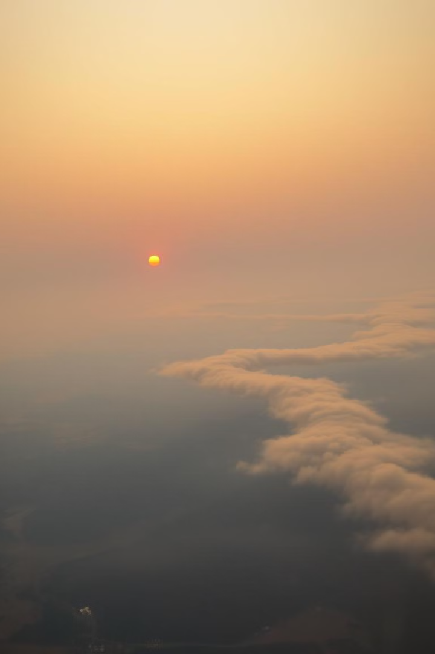
Wildfires and Washington Air Quality: The 2015 Crisis
Wildfires significantly impacted Washington's air quality in 2015.
This presentation explores the crisis and its effects on Washingtonians.
DM
by David Melesse

Slide 2
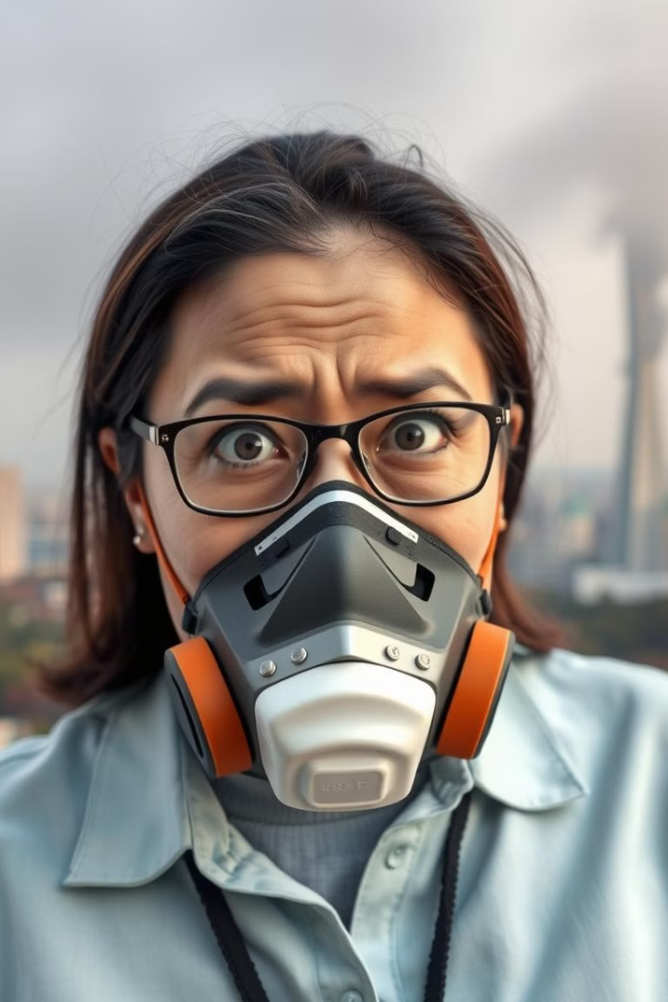



Why Should Washingtonians Care? Health Impacts of PM2.5
Respiratory Issues
Cardiovascular Problems
Vulnerable Groups
PM2.5 can cause asthma and bronchitis.
Increases risk of heart attacks and strokes.
Children and elderly are most at risk.

Slide 3
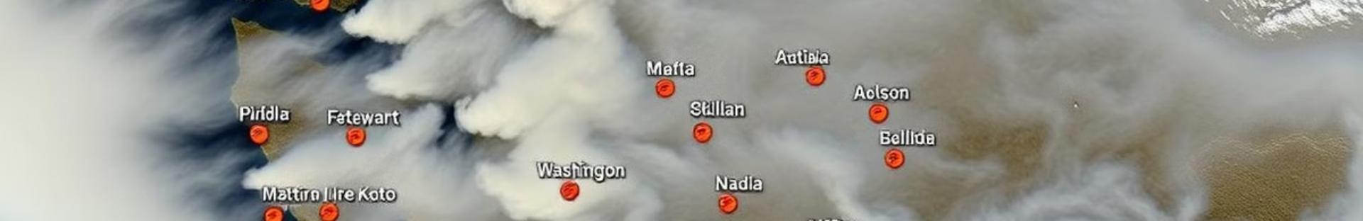
Wildfire Season 2015: A Defining Moment for Air Quality
Record-Breaking Fires
1
Unprecedented number of acres burned.
2
Statewide Emergency
Declared due to hazardous air quality.
Health Alerts
3
Issued for vulnerable populations across WA.

Slide 4
Understanding PM2.5: What It Is and Why It's Harmful
Tiny Particles
Inhalation Risk
Source Variety
PM2.5 are particulate matter 2.5 micrometers or less in diameter.
Easily inhaled deep into the lungs, causing damage.
Comes from combustion, industry, and wildfires.

Slide 5
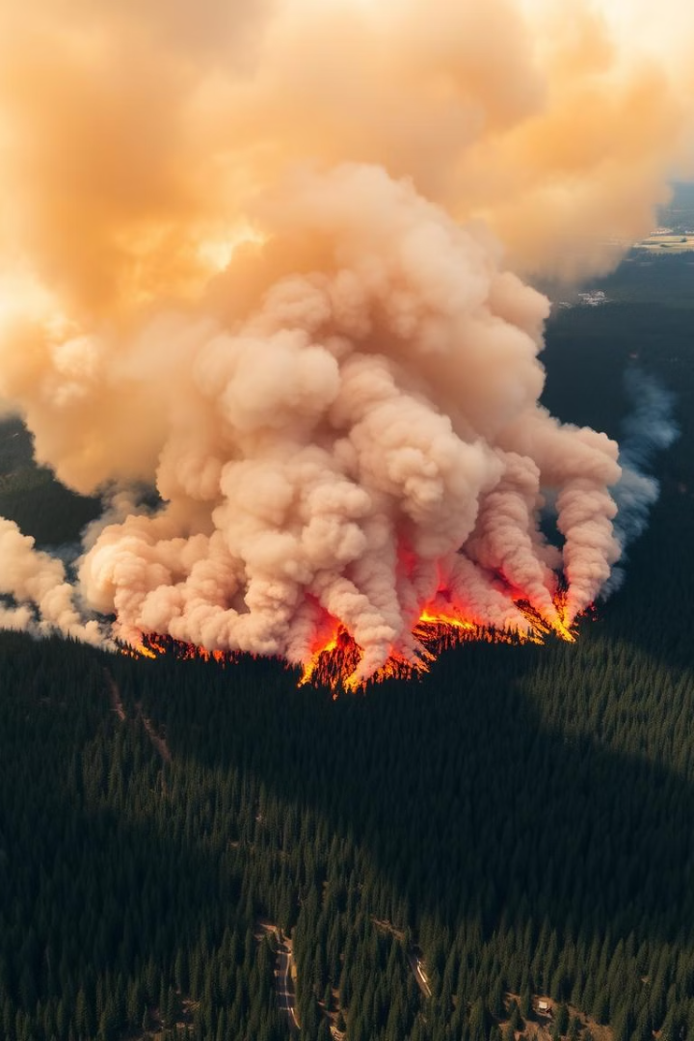
The Link: Wildfires as a Major Source of PM2.5
1
Smoke Composition
2
Vast Coverage
Wildfire smoke is full of PM2.5.
Fires release PM2.5 across large areas.
3
Prolonged Exposure
Smoke events last for days or weeks.

Slide 6
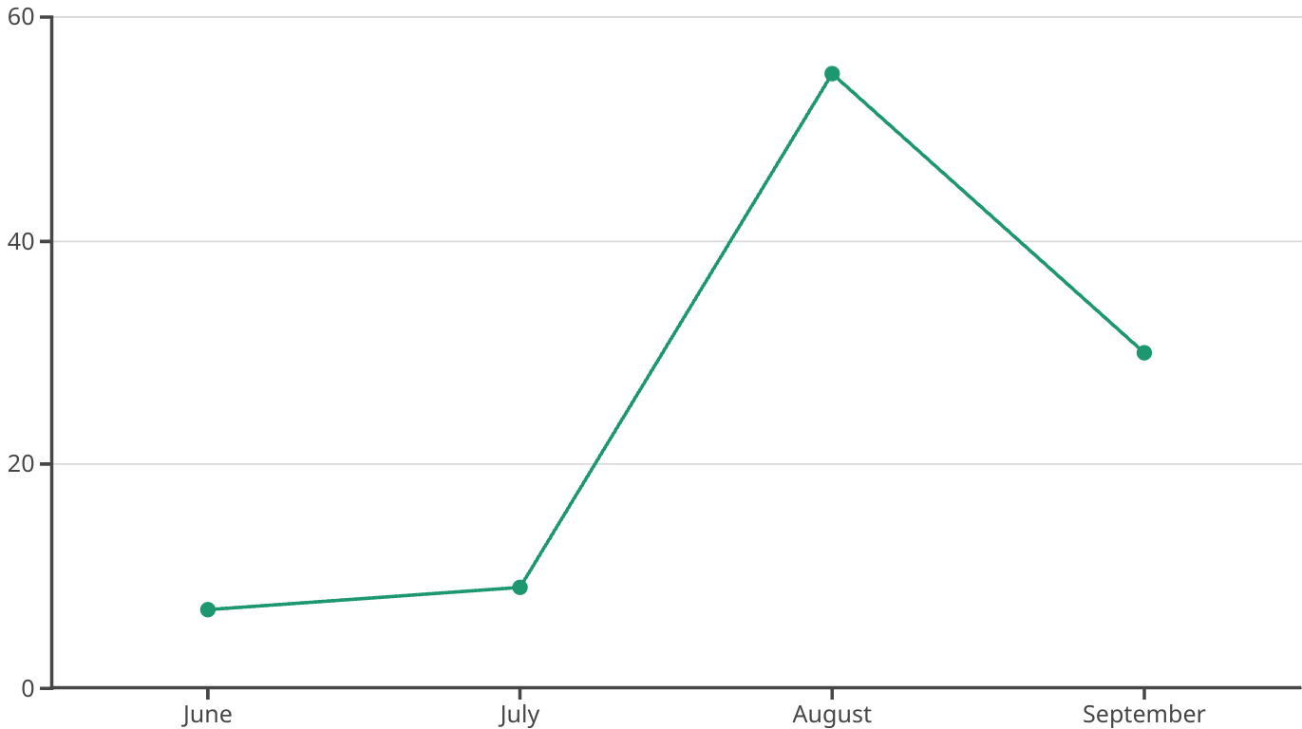
Visualizing the Data: Comparing Air Quality Before and After

Slide 7
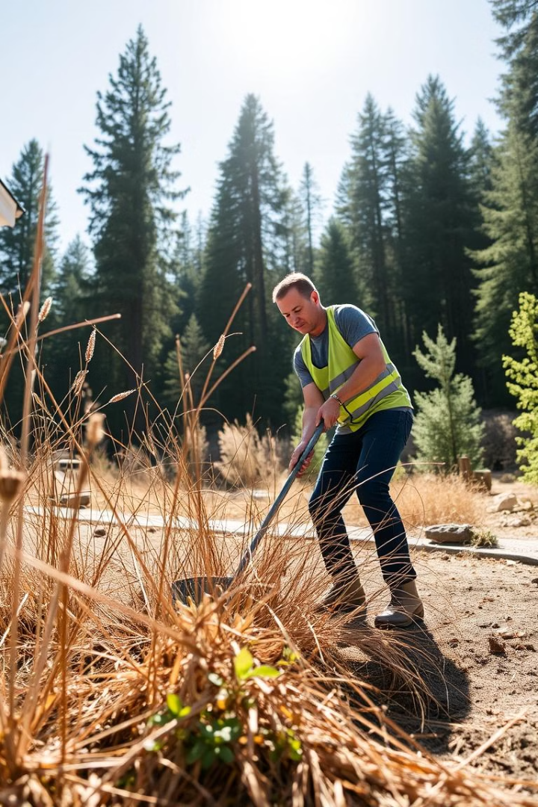




Simple Steps: Preventing Wildfires and Reducing Risks
Be Careful
Use care with matches and campfires.
Clear Brush
Create defensible space around homes.
Stay Informed
Check fire weather forecasts.
Report Fires
Report any unattended flames immediately.

Slide 8



Call to Action: Protecting Our Air, Protecting Ourselves
Community Action
1
Support local prevention efforts.
Individual Responsibility
2
Be cautious to prevent fires.
Stay Vigilant
3
Monitor air quality reports.

